Slide 1
Hashing
A hashtable is a data structure that stores (key, value) pairs so that given a key x, we can efficiently find the value associated with x (if any)
Key idea: Use an array T[0.. m−1] and choose a hash function that maps keys to array indices
Notation: Keys are chosen from a set K of size n; h(x) ∈ {0, …, m−1}
If m < n, there will clearly be collisions (Pigeonhole Principle)
i.e., for distinct x and y, h(x) = h(y)
collisions may occur when m ≥ n for some hash functions
We want:
a fast to compute hash function that minimizes collisions
a way to deal with collisions in case they arise

Slide 2
Determinism or Randomization?
If we pick a deterministic hash function for our program, then each time our program is run each pair of keys x and y will either always collide or never collide
if we have several collisions for some input, we will always have several collisions for that input
e.g., h(x) = integer(x) mod m
We need randomization, but our hash function cannot be random (why?)
Solution: Choose a hash function h uniformly at random from a family of hash functions F
each h ∈ F is deterministic
Ideal (?): F is the set of all possible functions from K to {0, …, m−1}
many of these have no simple representation

Slide 3
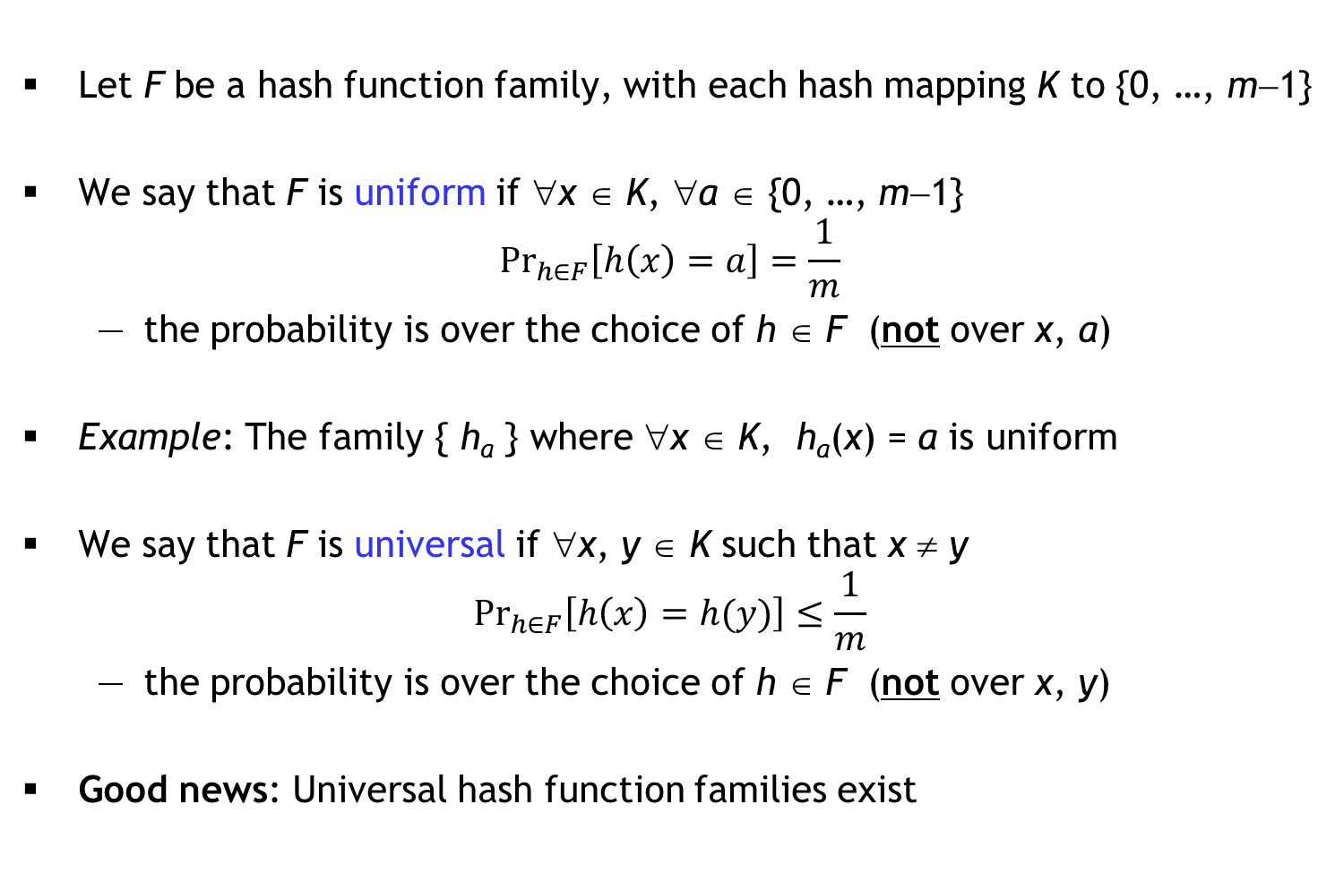
Uniform and Universal hash function families
Let F be a hash function family, with each hash mapping K to {0, …, m−1}
We say that F is uniform if ∀x ∈ K, ∀a ∈ {0, …, m−1}
$${Pr}_{h∈F}\left[h\left(x\right)=a\right]=\frac{1}{m}$$
the probability is over the choice of h ∈ F (not over x, a)
Example: The family { h_{a} } where ∀x ∈ K, h_{a}(x) = a is uniform
We say that F is universal if ∀x, y ∈ K such that x ≠ y
$${Pr}_{h∈F}\left[h\left(x\right)=h(y)\right]≤\frac{1}{m}$$
the probability is over the choice of h ∈ F (not over x, y)
Good news: Universal hash function families exist
but not
universal!

Slide 4
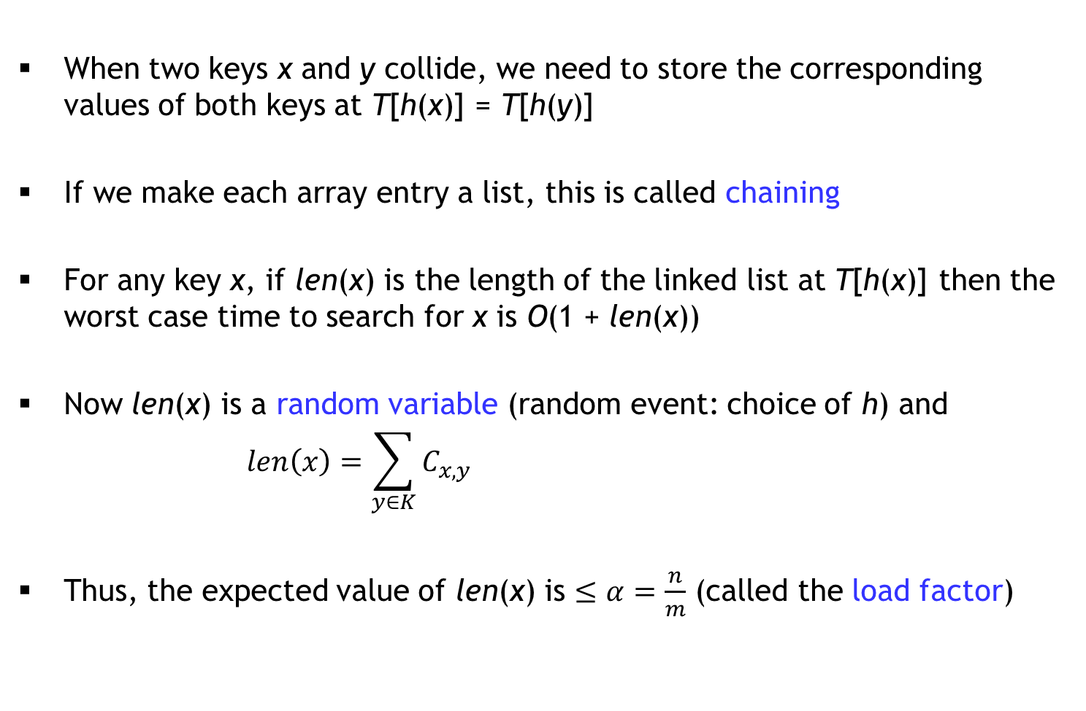

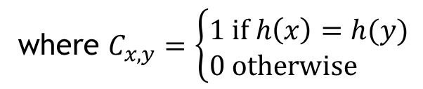
Chaining
When two keys x and y collide, we need to store the corresponding values of both keys at T[h(x)] = T[h(y)]
If we make each array entry a list, this is called chaining
For any key x, if len(x) is the length of the linked list at T[h(x)] then the worst case time to search for x is O(1 + len(x))
Now len(x) is a random variable (random event: choice of h) and
$$len\left(x\right)=\sum_{y∈K}{C_{x,y}}$$
Thus, the expected value of len(x) is $≤α=\frac{n}{m}$ (called the load factor)
where $C_{x,y}=\left\{\begin{matrix}1 if h\left(x\right)=h(y) \\ 0 otherwise \end{matrix}\right.$
prob.$≤\frac{1}{m}$

